Slide 1
Final Code Presentation
Yishuo Wang
108533945

Slide 2
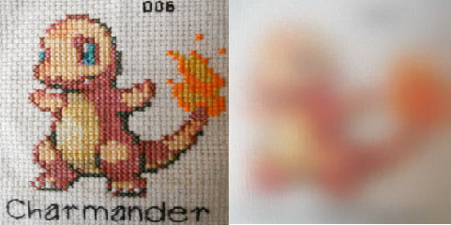
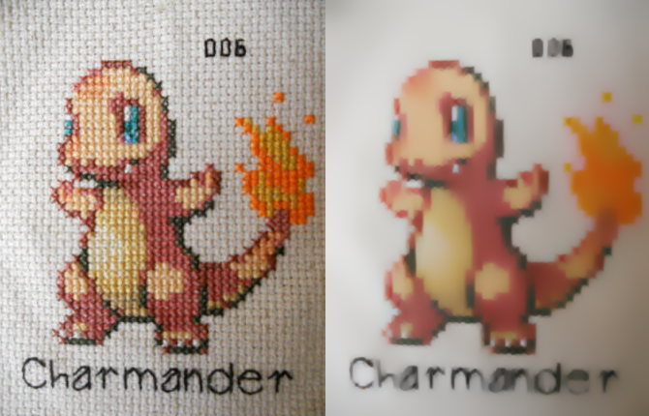
Bad result and good result

Slide 3
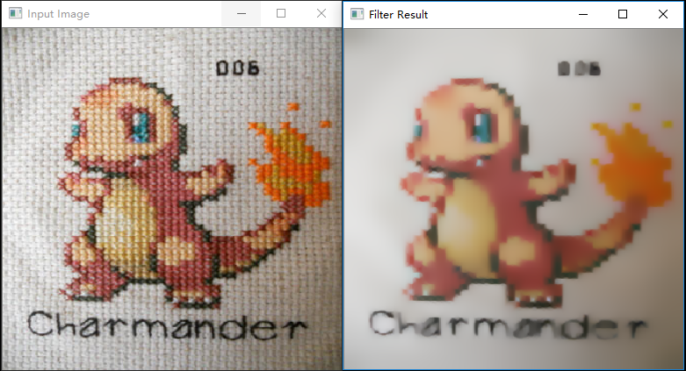
Pokemon

Slide 4
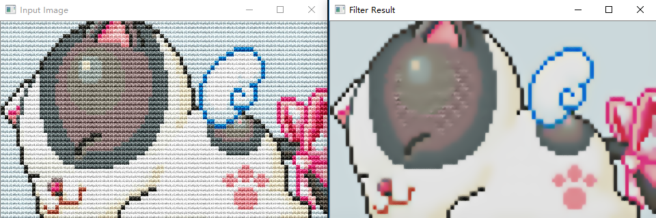
Cat

Slide 5
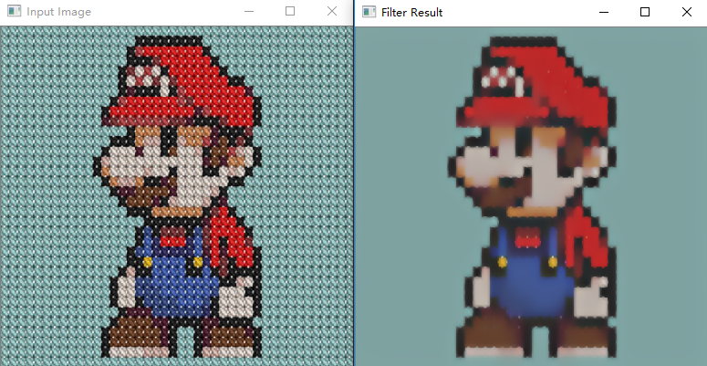
Super Mario

Slide 6
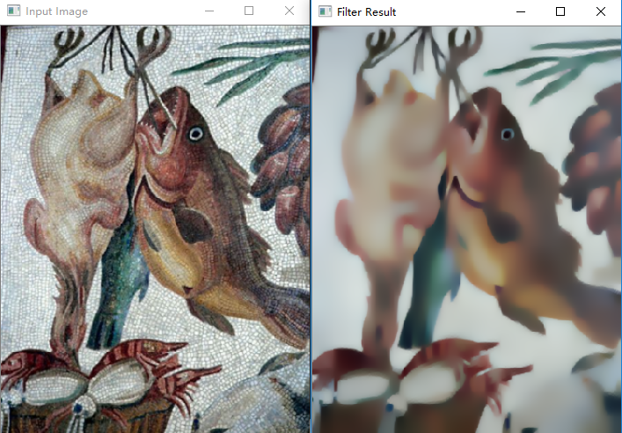
Fish

Slide 7
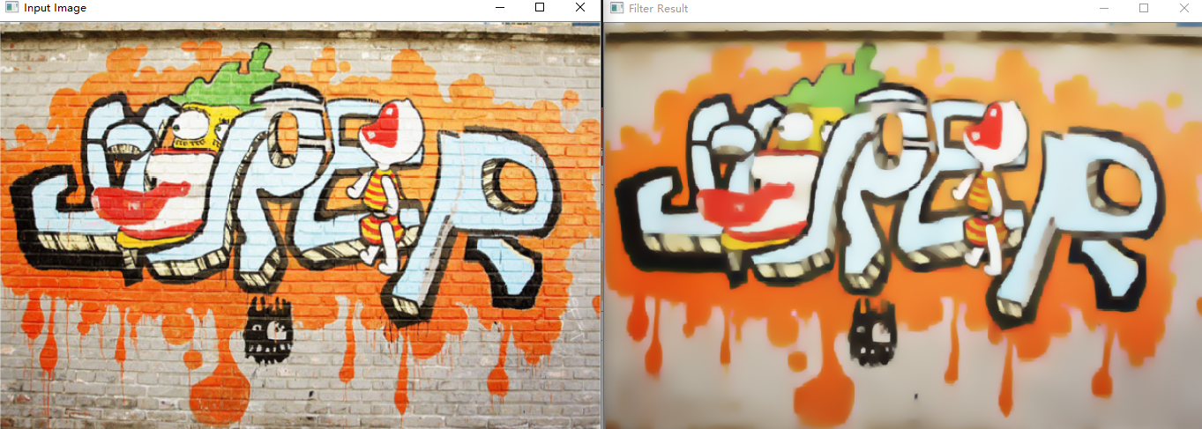
Wall

Slide 8
Thank You!

